Slide 1
CSS Transitions
Nikkala Thomson, CIT 261

Slide 2
basics
Trigger transitions with JavaScript events or :hover.
No need to use prefixes with transitions: http://shouldiprefix.com/
Properties that can be transitioned: https://developer.mozilla.org/en-US/docs/Web/CSS/CSS_animated_properties
Essential properties of a transition: property (e.g. width) and duration (e.g. 2s)
Optional properties of a transition: timing-function (e.g. linear) and delay

Slide 3
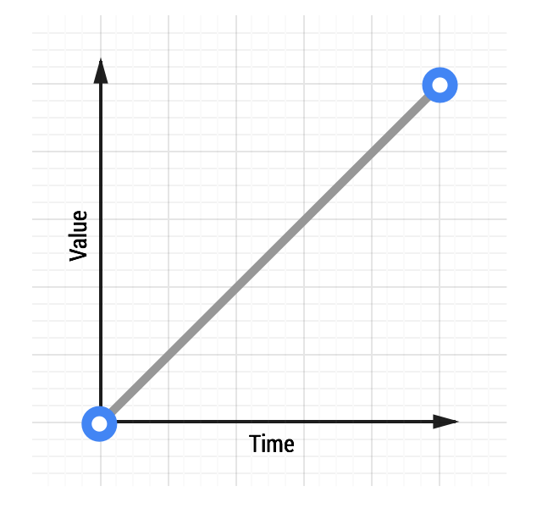
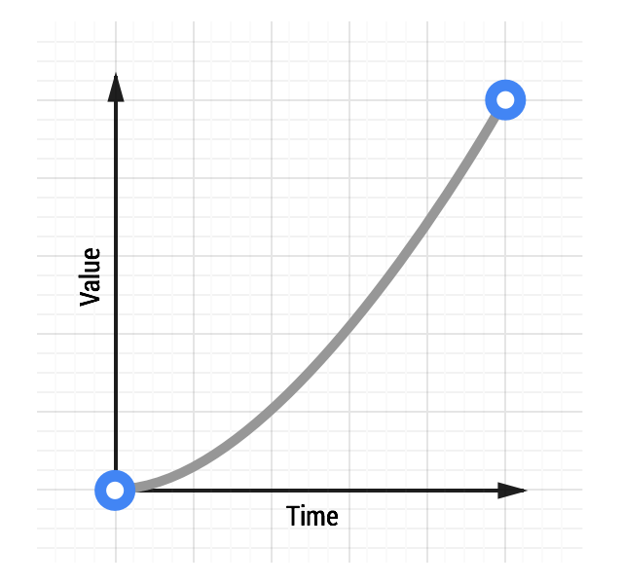
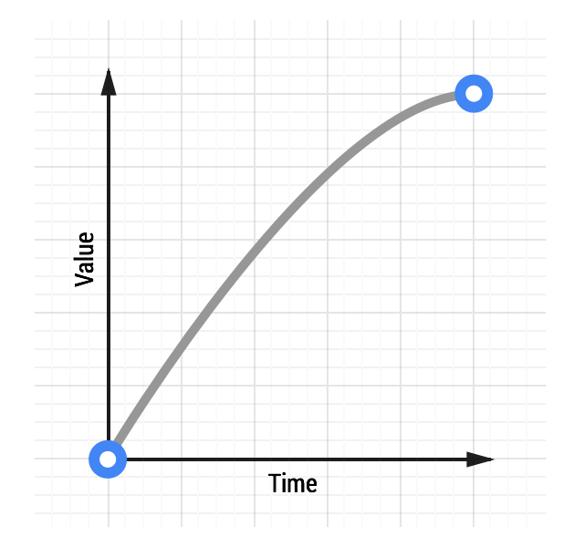
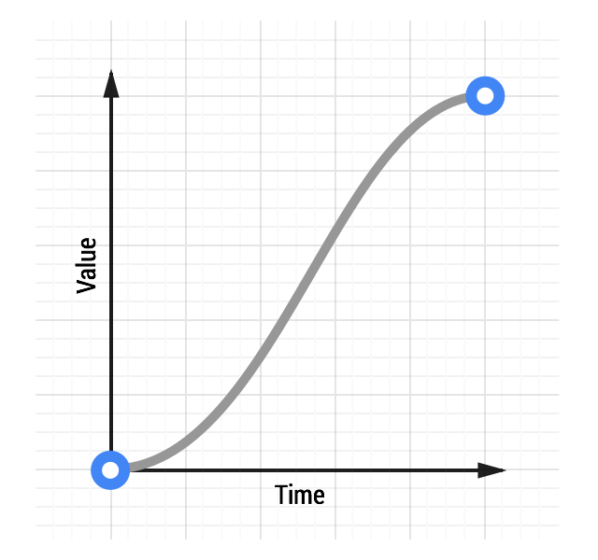
timing functions
Using an ease-style timing function can feel more natural to users
Choose ease-out animations for UI functions
Avoid ease-in or ease-in-out animations unless they are short (300-500ms); they can feel sluggish to users
ease: default timing function; it has a slightly slow start and slightly fast end
linear ease-in ease-out ease-in-out

Slide 4
a simple example
div { width: 100px;
transition-property: width;
transition-duration: 2s;
transition-timing-function: ease-in;
transition-delay: 1s;
}
/* same as */
div { transition: width 2s ease-in 1s; }
div: hover { width: 200px; }

Slide 5
javascript triggered example
HTML:
<div class=“box” id=“box1”> </div>
<button id=“go”>Let’s Go!</button>
CSS:
.box { width: 300px; height: 300px; transition: width 2s, height 2s; }
.box-change { width: 500px; height: 500px; }
JavaScript:
var element=document.getElementById(‘box1’); //select target element
var trigger=document.getElementById(‘go’); //select trigger element
trigger.addEventListener(‘click’,function(e) {
e.preventDefault(); //stop default action
element.classList.toggle(‘box-change’); //toggle class on or off
});

Slide 6
beyond the basics
“auto” doesn’t work well with transitions (e.g. “height: auto;”)
For workarounds see https://css-tricks.com/using-css-transitions-auto-dimensions/
Transitions may not work if used right after “.appendChild()” or removing “display:none;”. To fix, use “window.setTimeout(function,milliseconds)” and use the function to change the CSS property you wish to transition.
You can execute multiple transitions simultaneously, including transforms.
Use “transitionend” as event handler that fires at the end of a transition (“transitionrun” and “transitionstart” are not supported in all browsers)

Slide 7
mismatched lists
When a property value list is too short, its values are repeated. Example:
div { transition-property: opacity, left, top, height;
transition-duration: 3s, 5s; }
is understood as
transition-duration: 3s, 5s, 3s, 5s; }
When a property value list is too long, its values are truncated. Example:
div { transition-property: opacity, height;
transition-duration: 3s, 5s, 3s, 5s; }
becomes
transition-duration: 3s, 5s; }

Slide 8
references
https://developer.mozilla.org/en-US/docs/Web/CSS/CSS_Transitions/Using_CSS_transitions
https://developers.google.com/web/fundamentals/design-and-ux/animations/the-basics-of-easing
http://easings.net/

